Slide 1




Slide 2
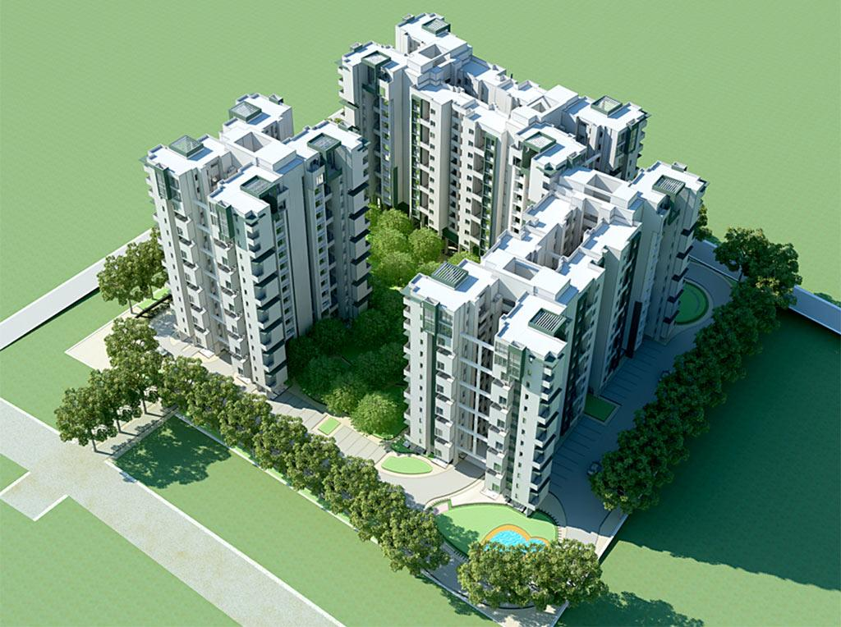

Slide 3
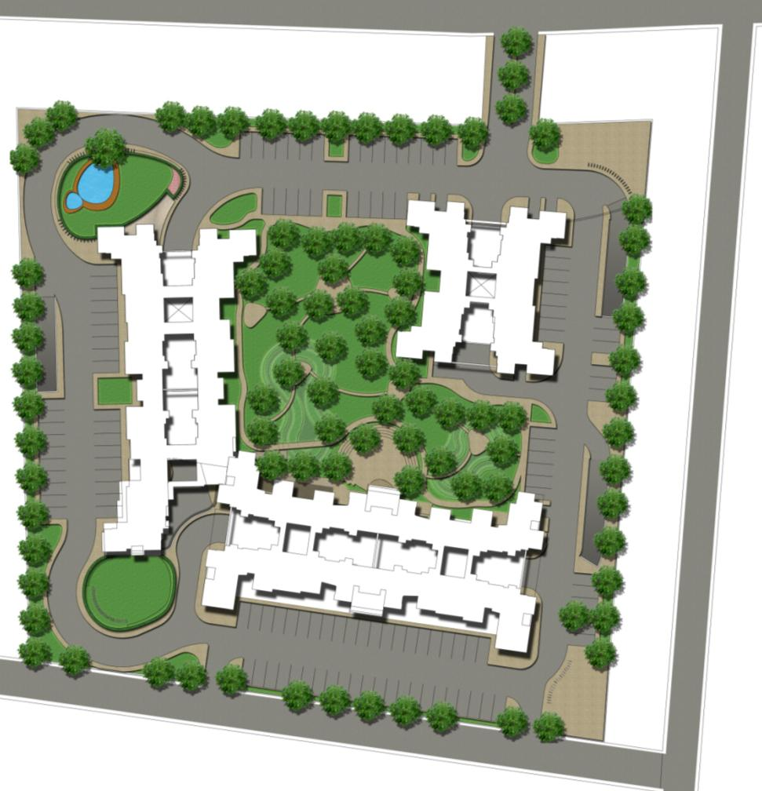
8
9
13
1
Site Plan
10
Apartment entrance
Apartment block
A Stilt+15 floors
B Stilt+13 floors
C Stilt+comm+12
Mid-size retail
Commercial entrance (In/Out)
Central forest
External covered parking
Driveway
STP
Transformer yard
Amenities
Activity area/ Play area
Ramps to basement
Visitors parking
Commercial parking
2A
5
7
6
2B
2C
3
11
14
4
9
4

Slide 4
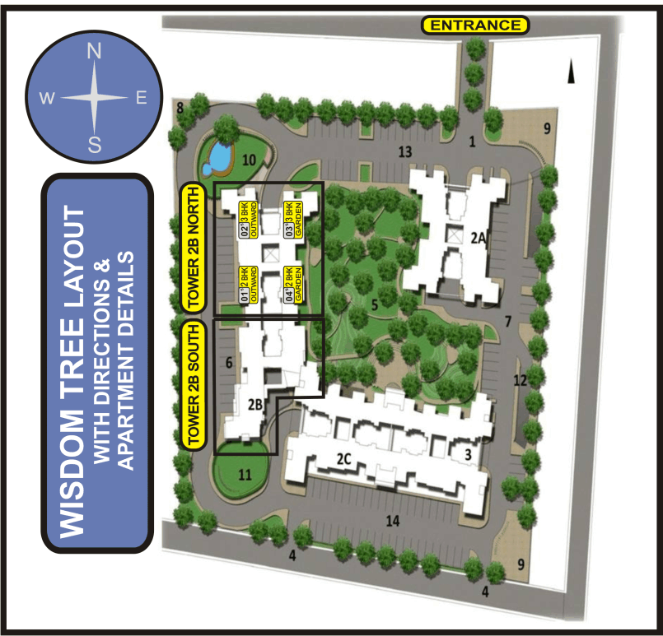

Slide 5
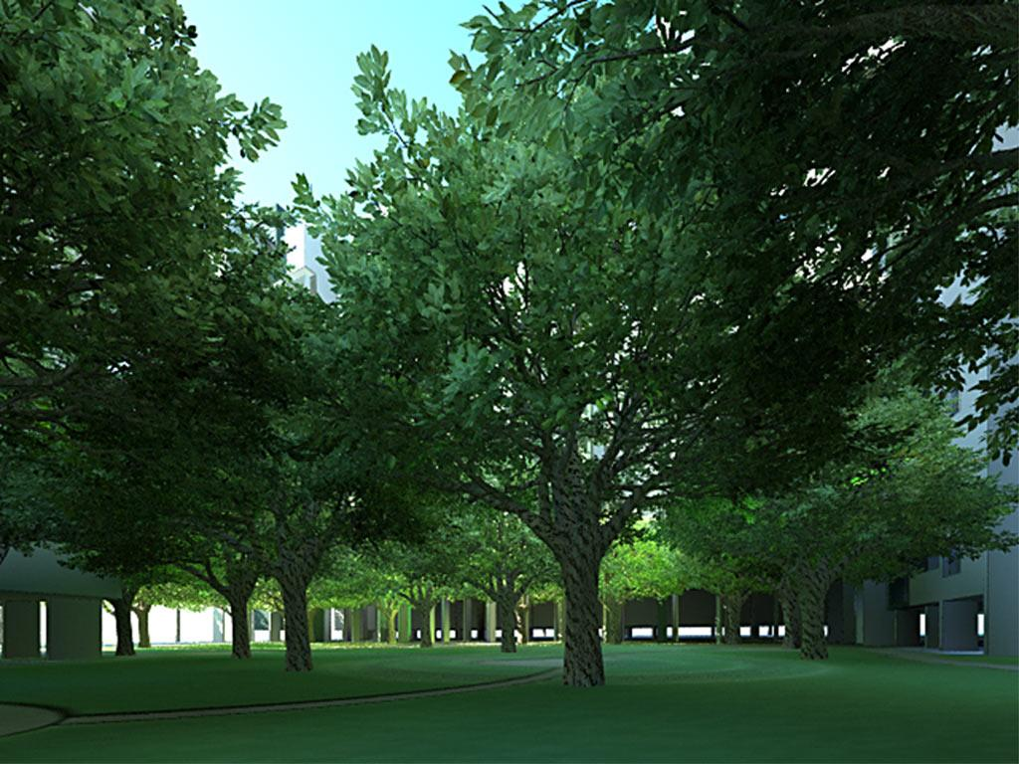
Central Forest

Slide 6
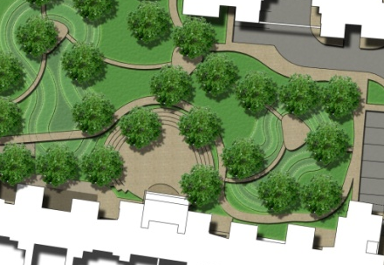
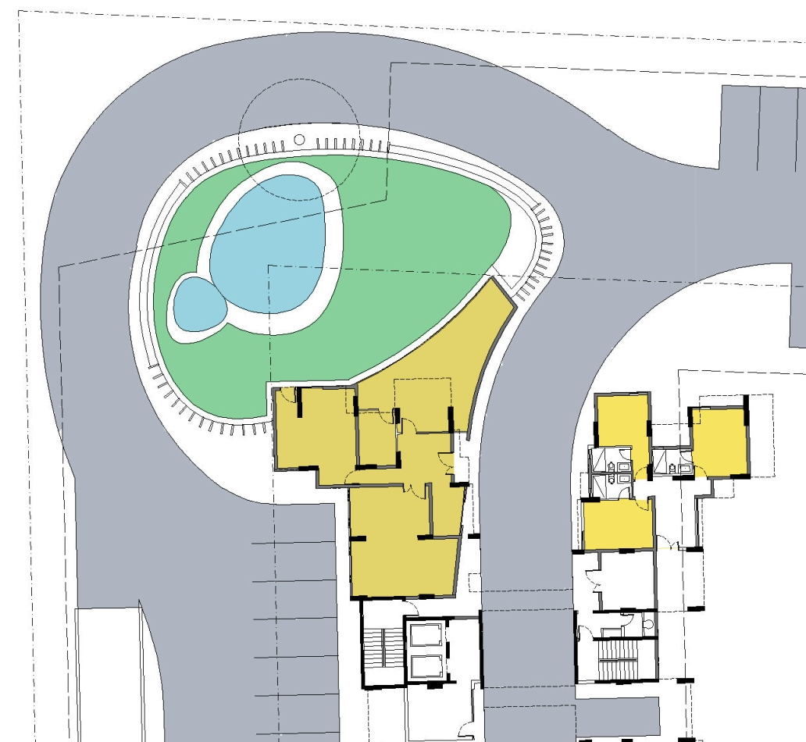
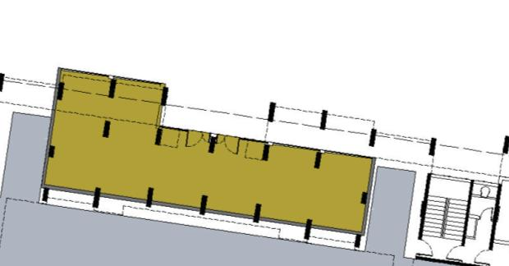
1
1
Facilities Wise
3
8
Existing Banyan tree - Backdrop/ focal point for pool
Pool
Lawn
Crèche
Sauna/ steam & bathroom/ toilets
Gym
Guest rooms
Sports hall/ Multi-function hall – opens into open air theatre (spill over space). Tucked below the retail for aural privacy to apartments
2
3
4
5
6
7

Slide 7
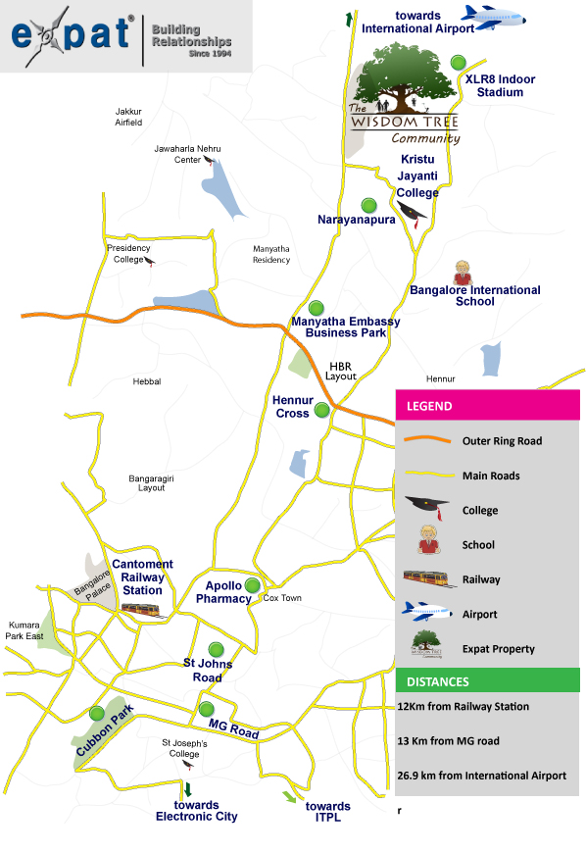
Location Wise
M. G. Road – 13 kms
Bangalore International Airport – 27 kms
Railway Station – 11kms
Manyatha Tech Park – 4.5kms
Bangalore International School – 1.5 Kms
Krishtu Jayanthi College – 0.5 km
Sundar Hospital – 7.2kms
Columbia Asia Hospital – 9.5 Kms
Whitefield – 25 minutes drive*
* Road being built to join Airport & Whitefield

Slide 8
Apartment Specifications
2 BHK Without Courtyard – 1221 Sq.ft.
2 BHK With Courtyard - 1360 Sq.ft.
3 BHK Without Courtyard - 1697 Sq.ft.
3 BHK With Courtyard - 1780 Sq.ft.

Slide 9
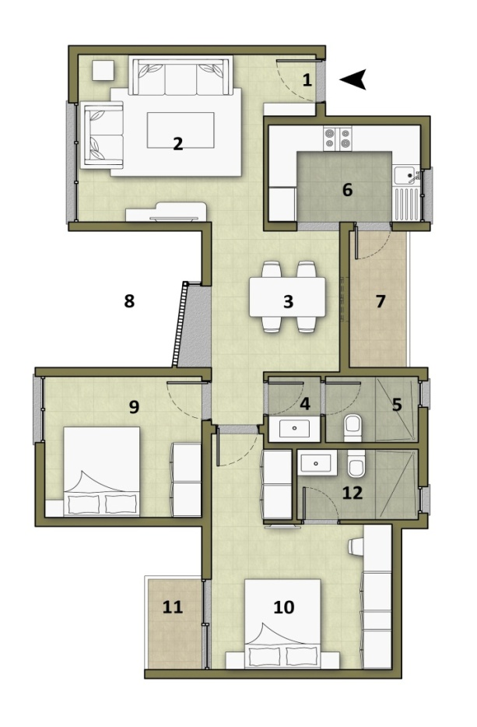
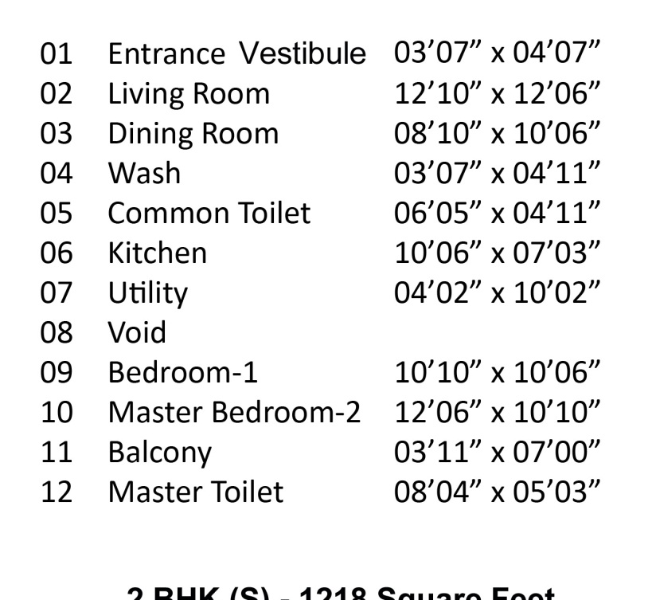
2 BHK Without Courtyard
*Indicative: This is not a legal offering. Drawings subject to change

Slide 10
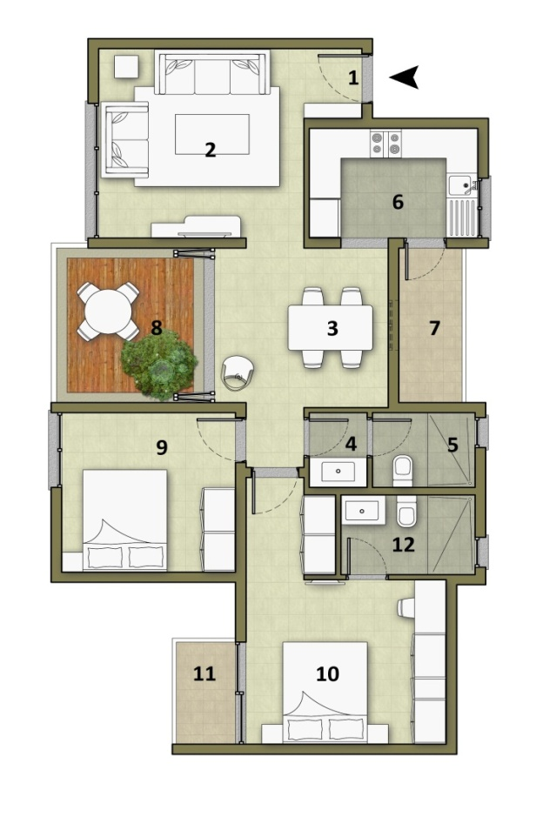
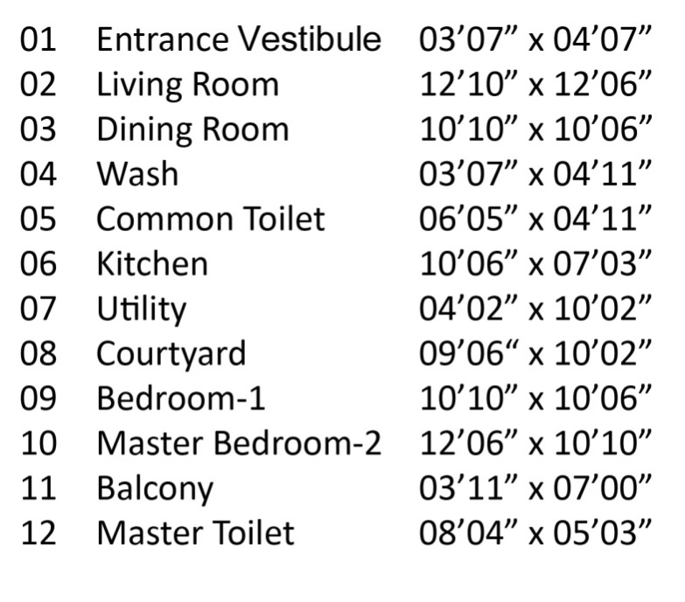
2 BHK With Courtyard
*Indicative: This is not a legal offering. Drawings subject to change

Slide 11
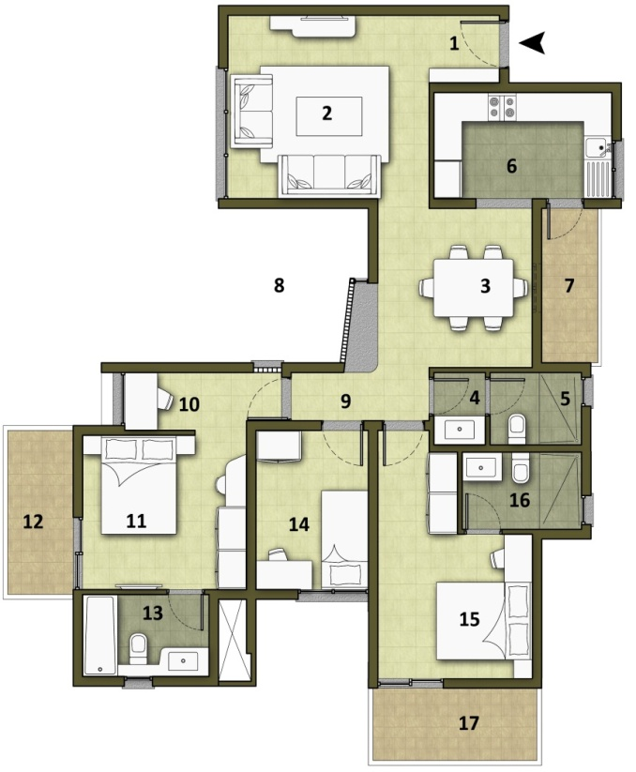
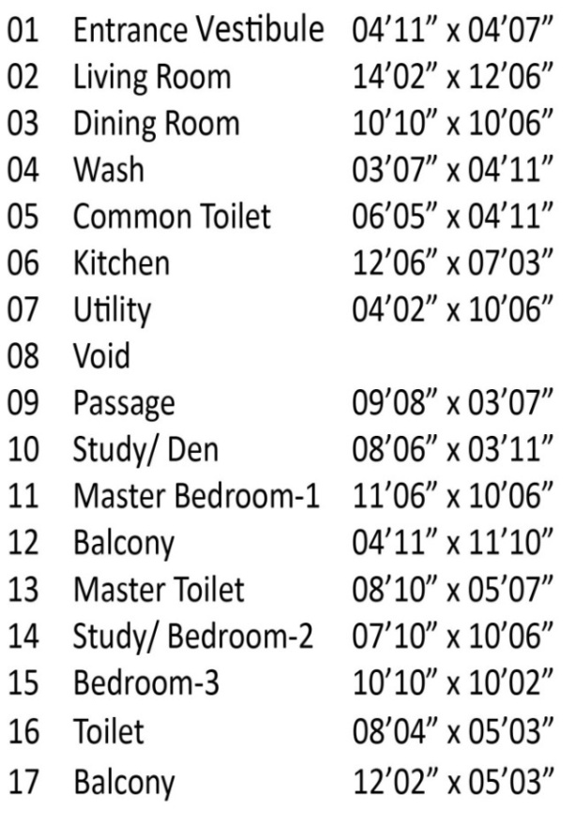
3 BHK Without Courtyard
*Indicative: This is not a legal offering. Drawings subject to change

Slide 12
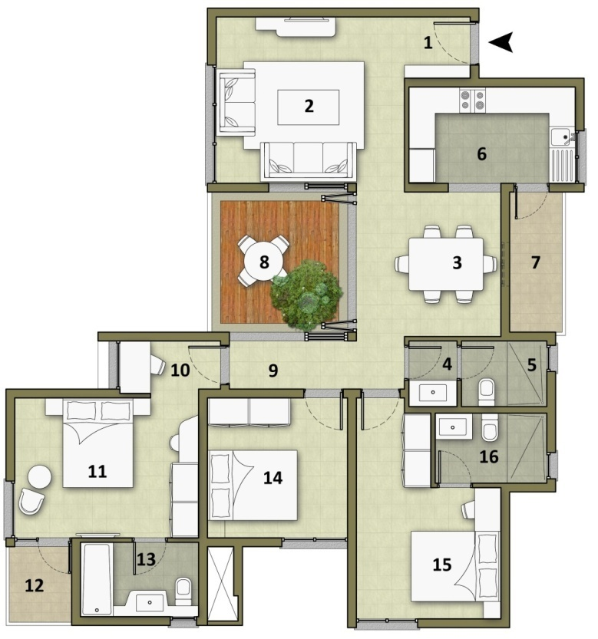
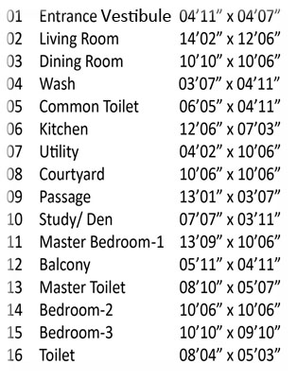
3 BHK With Courtyard

Slide 13
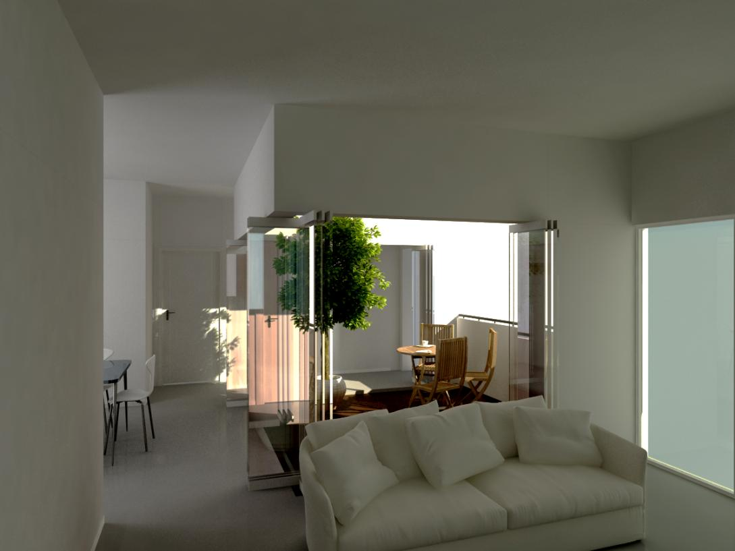
Living & Dining room interaction with Courtyard
Architectural Interiors
Note : Quality of spaces are achieved through use of natural elements. The views are deliberately not cluttered with colourful accessories such as photo frames, rugs, sculptures etc., to depict the above

Slide 14
Our Offer
Pre-launch Price - Rs 3,200 per Sq.ft (Base Price)
Launch Price - Rs 3,400 Sq.ft (Base Price)

Slide 15

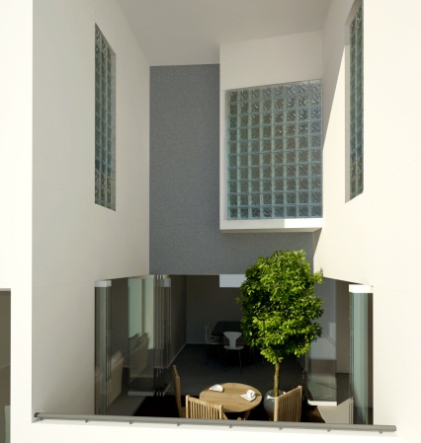
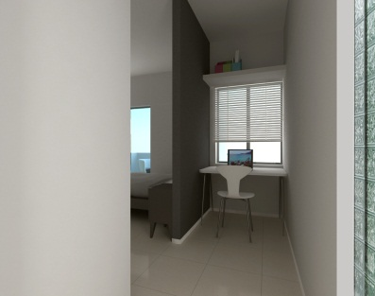
Lifestyle Wise
Large apartments with COURTYARD
Landscaped Gardens - 60% open spaces
Covered car park
Provision for charging electric vehicles
Children’s Play Area & Crèche
Car wash facility
*Indicative: This is not a legal offering. Drawings subject to change

Slide 16
Lifestyle Wise
Guest Rooms
Visitor’s Parking
Benefit of 2 Club Houses with Lifetime Membership in Balance The Club.
Swimming Pool
Gymnasium & Party Hall
Amphitheater
Provision for Piped Gas

Slide 17
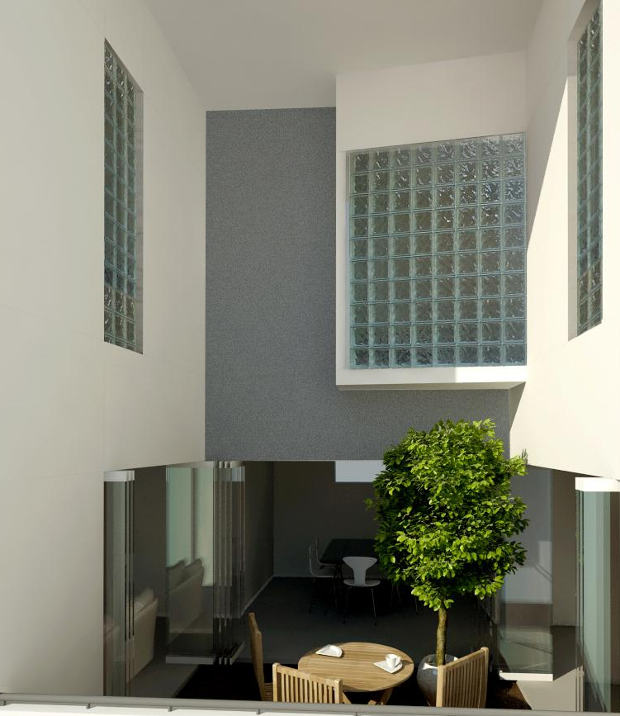
Privacy achieved through use of glass blocks
Double height courtyard

Slide 18
Facilities Wise
No shared wall between apartments
Provision for Commercial space, clinic & ATM
Provision of ramp for elderly and differently abled
Rain Water Harvesting
Waste Management System
Sewage Treatment Plant

Slide 19
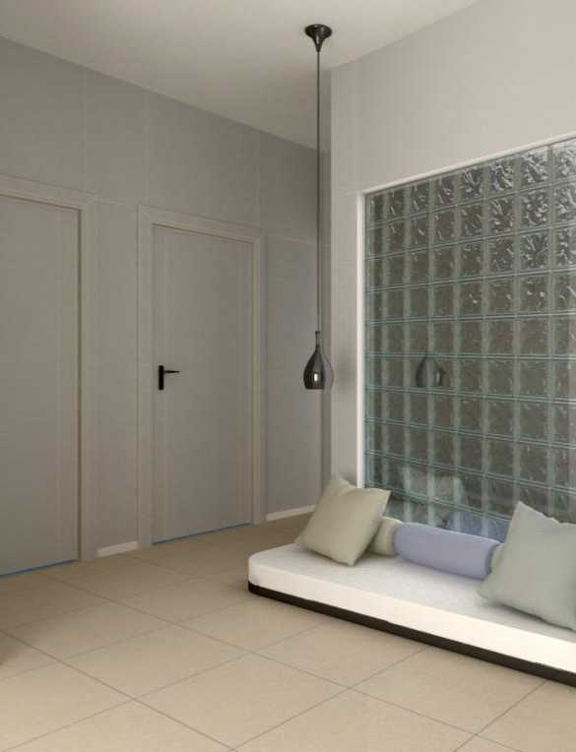
Carving more spaces… Creating that little extra bit
Architectural Interiors
Note : Efforts are taken to capture and show the uniqueness of the crafted spaces and spatial experience rather than showing the obvious
Informal corner

Slide 20
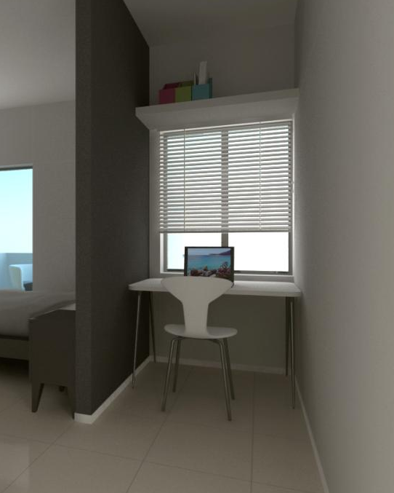
Carving more spaces
Architectural Interiors

Slide 21
Make a Wise decision Today and Realize Your Dreams at
“The Wisdom Tree Community” !

Slide 22
THANK YOU

